Slide 1
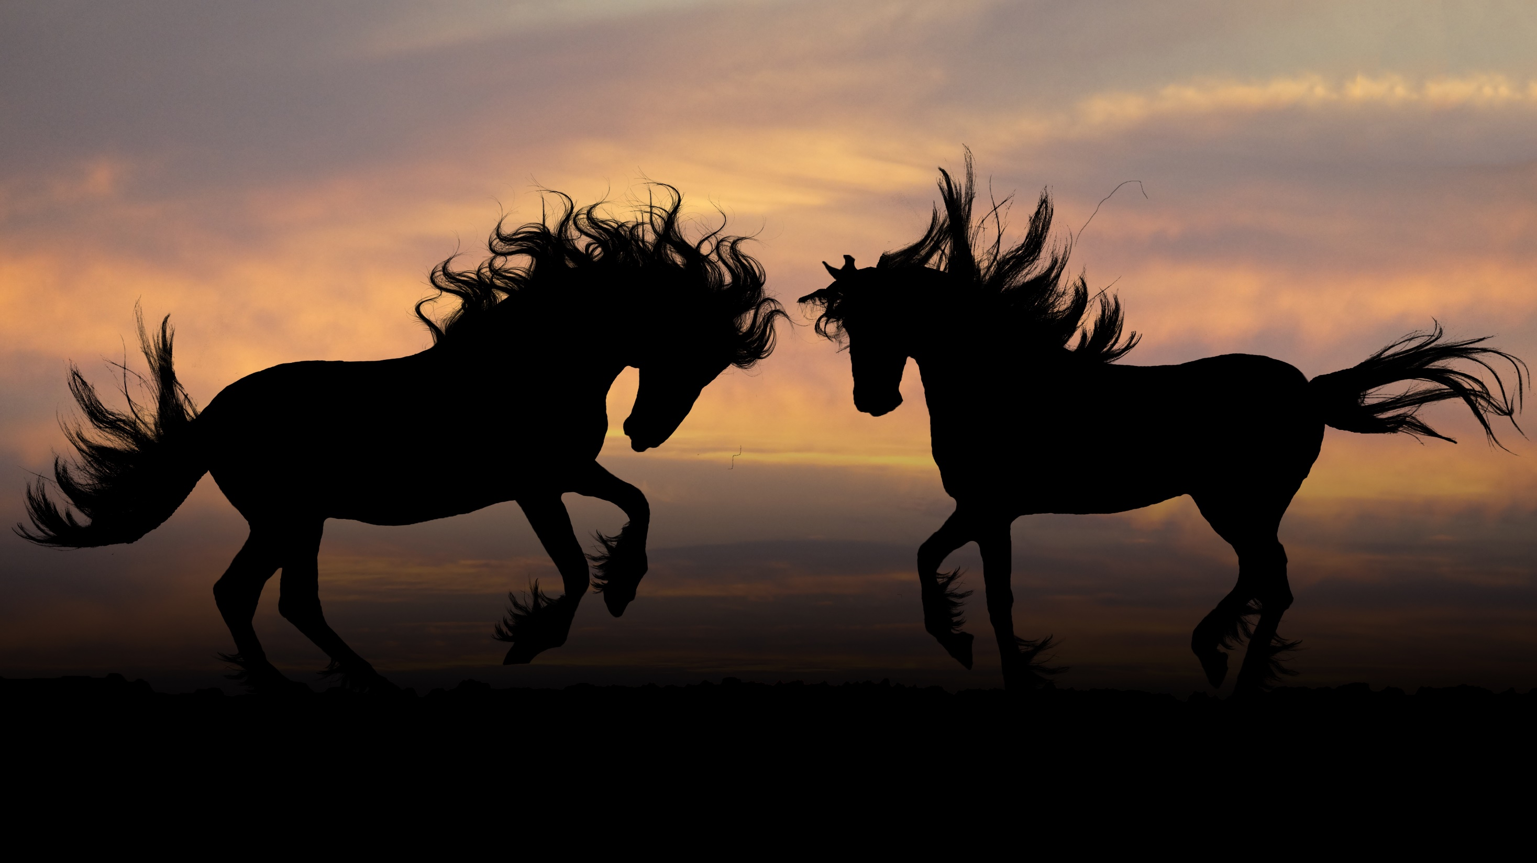


Dataset: Horse Movement Data and Analysis of its Potential for Activity Recognition
Jacob Kamminga, Nirvana Meratnia, Paul Havinga
Jacob Kamminga

Slide 2
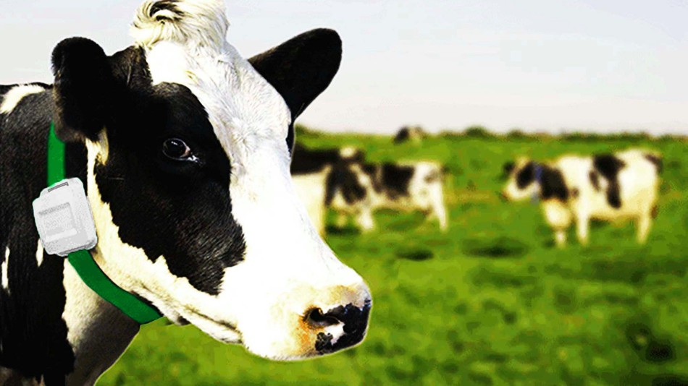
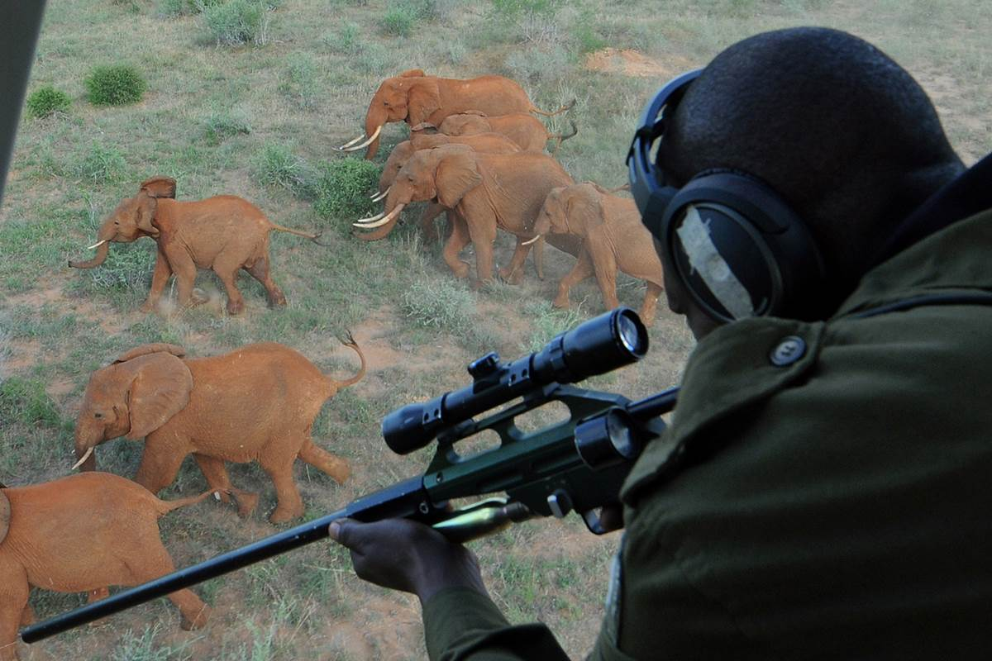
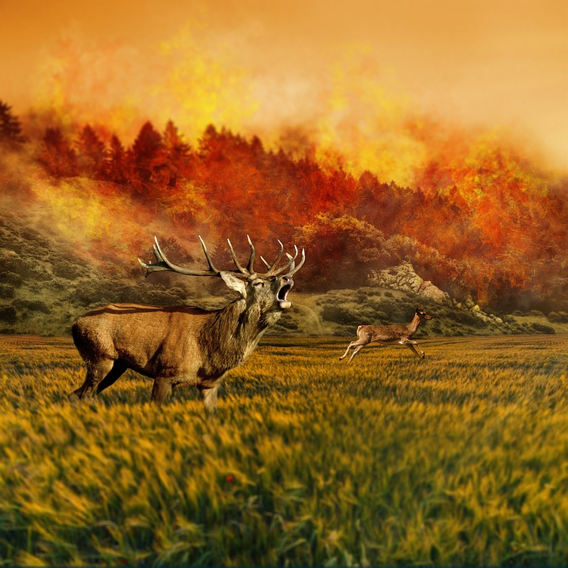
Animal Activity Recognition (AAR)
AAR provides large amount of information regarding the animal and its environment
Livestock management
E-health for pets
Detection of environmental effects such as forest fires and poaching
Movement ecology
Wildlife conservation
Notes:
Large amount of info not only about the animal, but also its environment

Slide 3
Data Acquisition
14 horses and 4 ponies
7 days of data collection

Slide 4
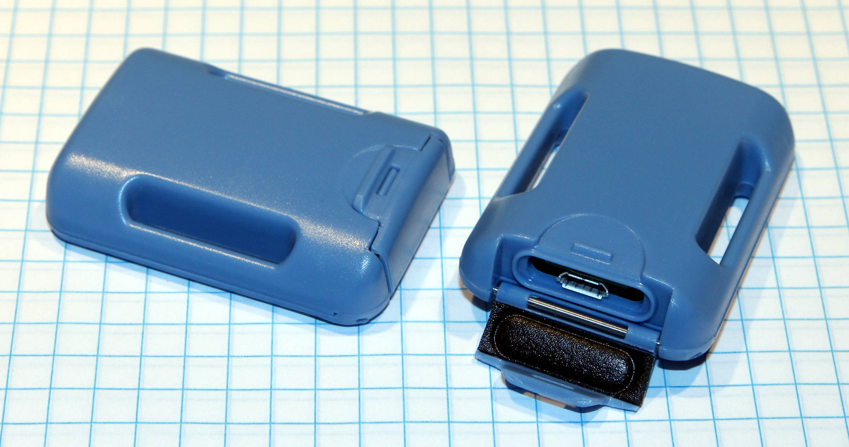
Sensors
GCDC Human Activity Monitor (HAM)
3D Accelerometer, 100Hz
3D Gyroscope, 100Hz
3D Magnetometer, 12Hz

Slide 5
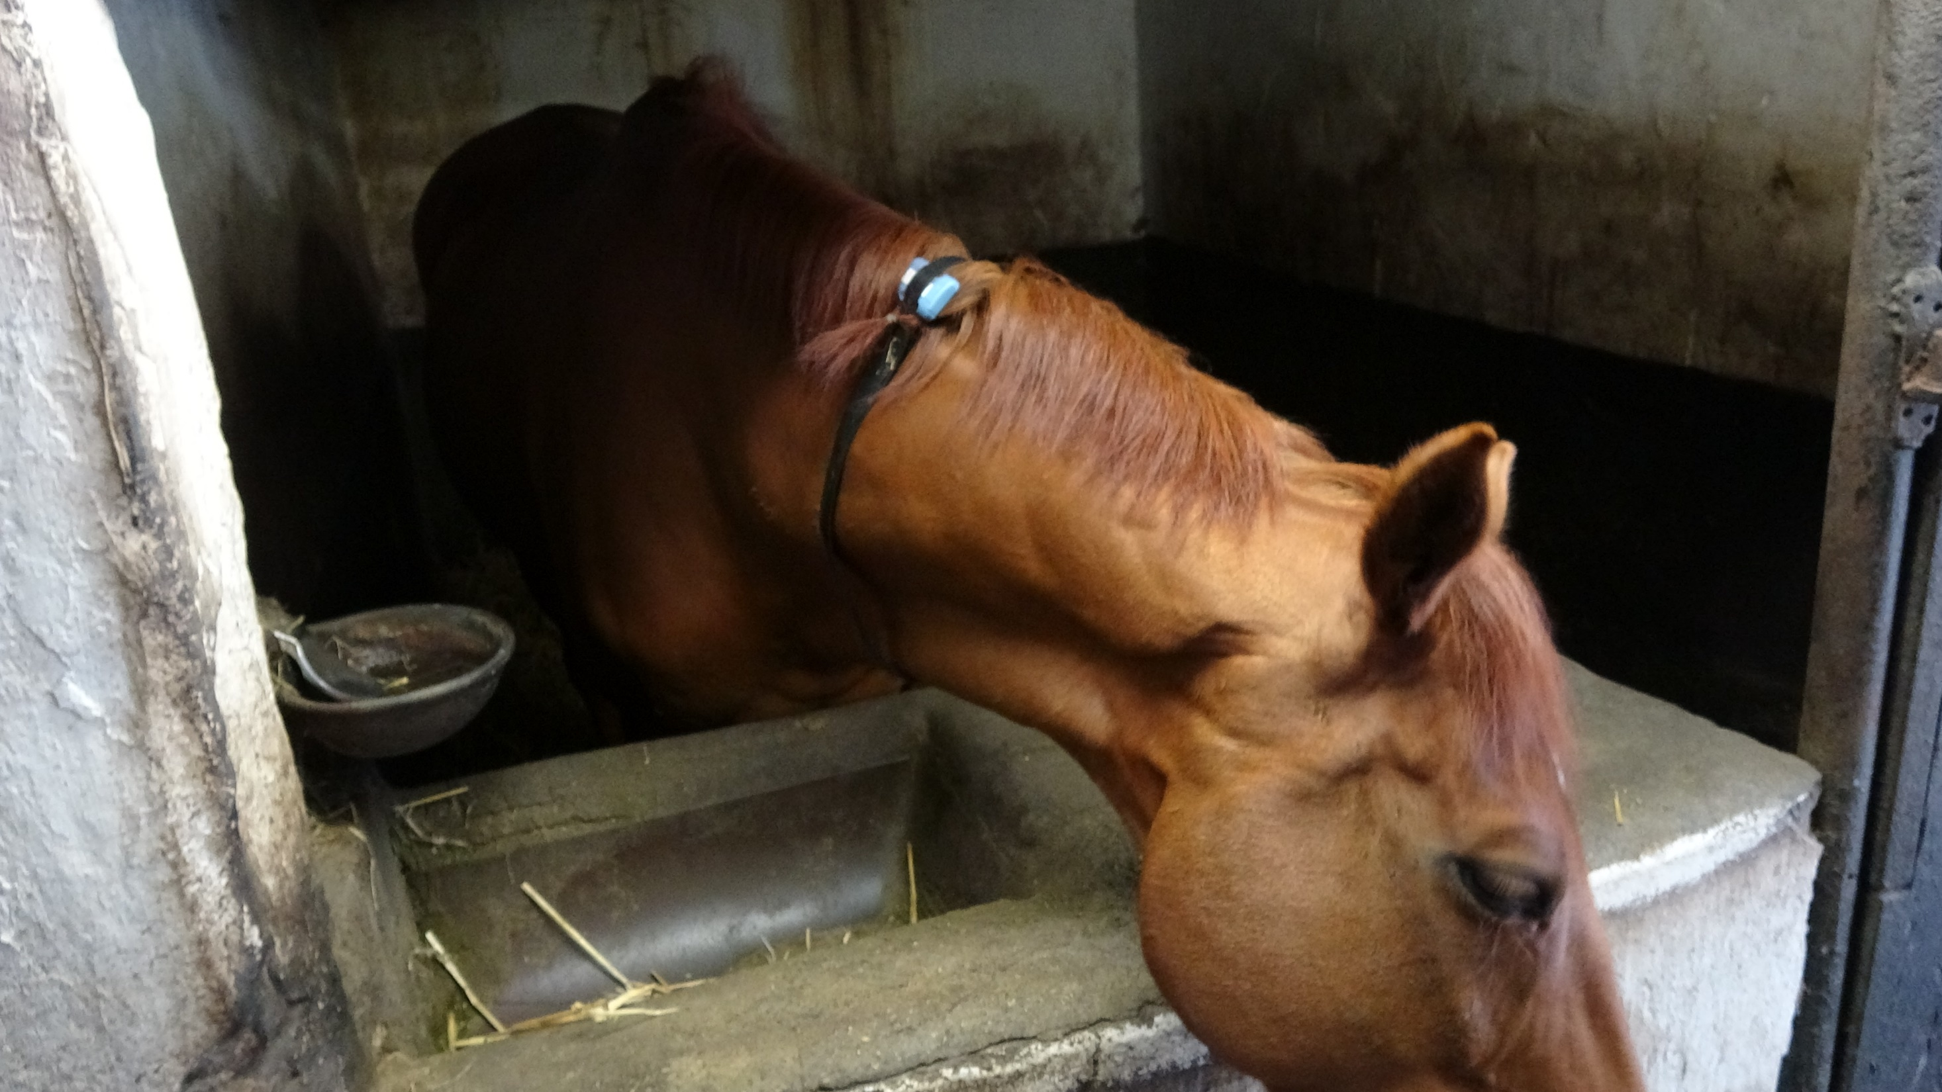
Sensor Placement
Notes:
Around Neck so that not halter or saddle is needed. Sensor location also used to monitor wildlife such as zebra.

Slide 6
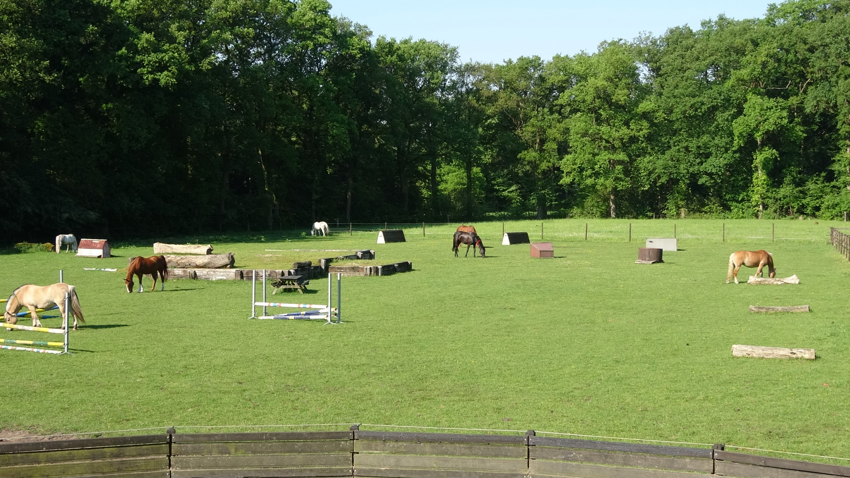
Notes:
Outdoor pasture

Slide 7
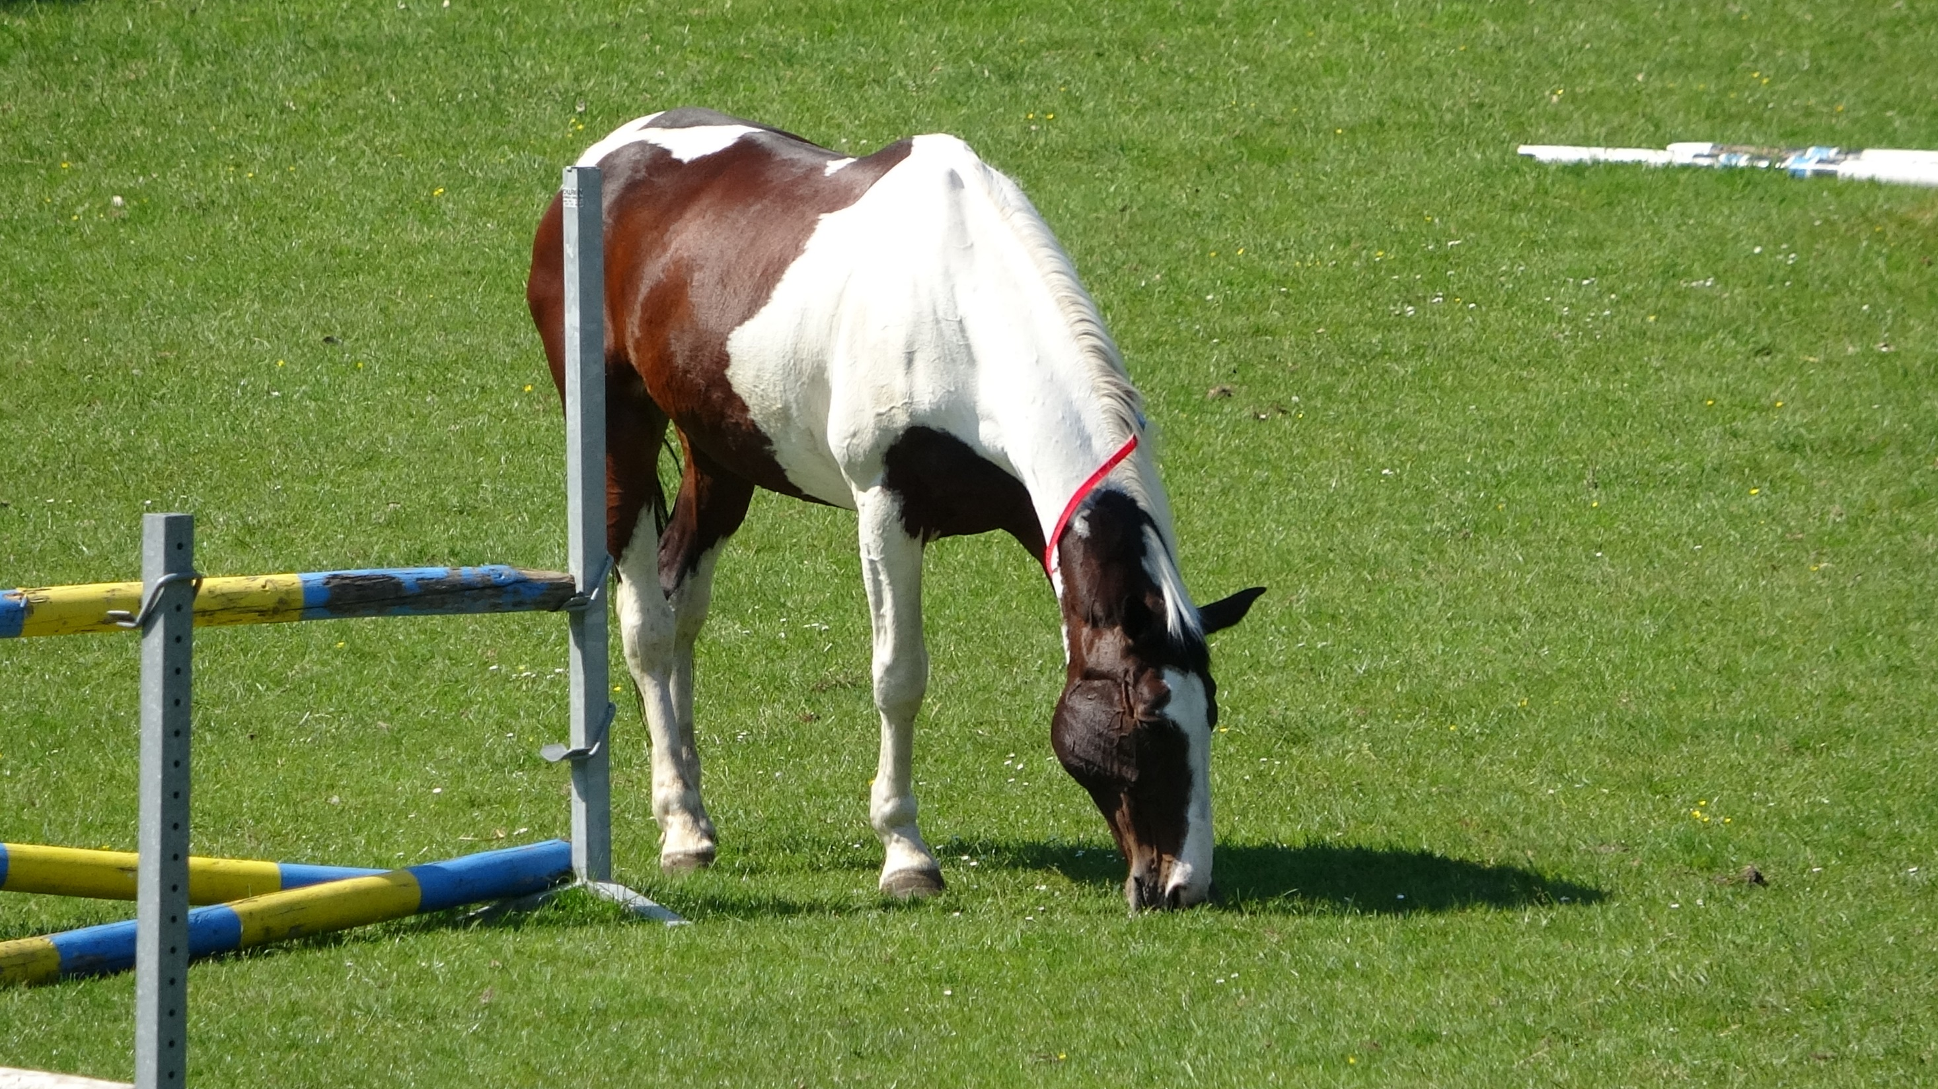
Notes:
Mostly grazing outside

Slide 8
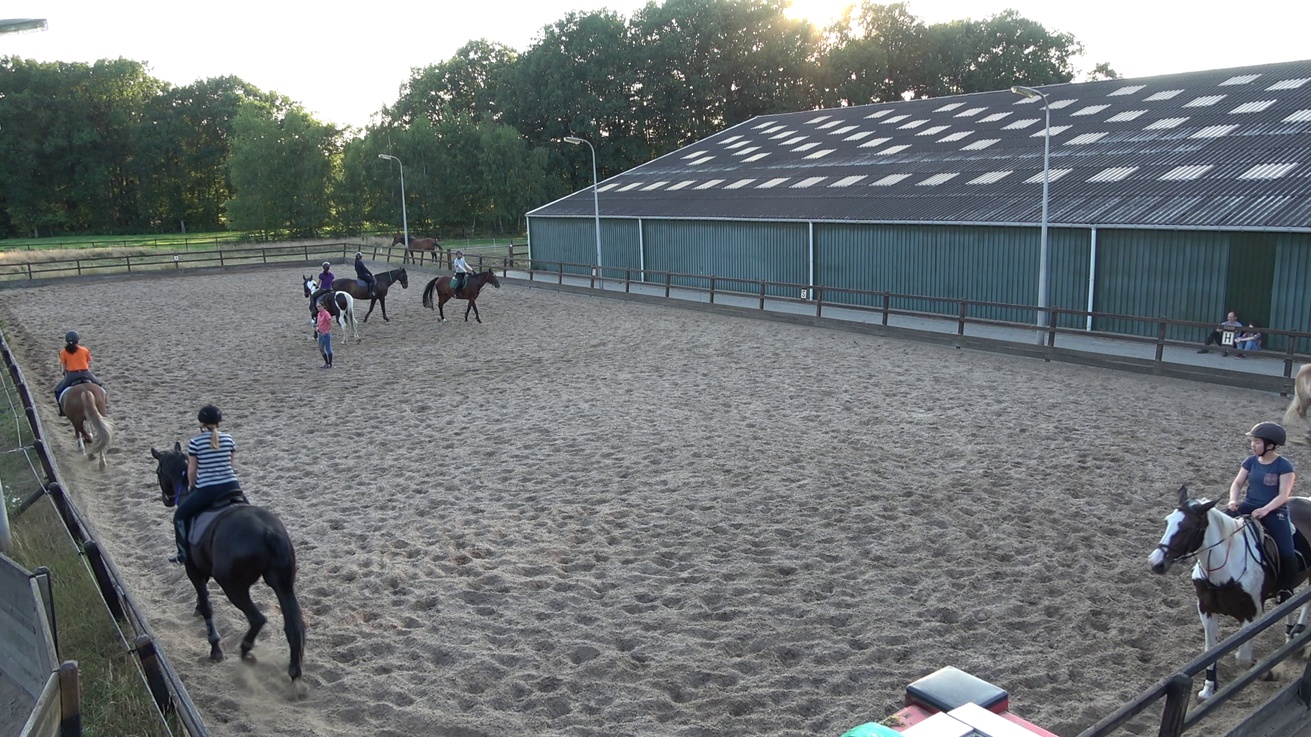
Notes:
Paddock

Slide 9
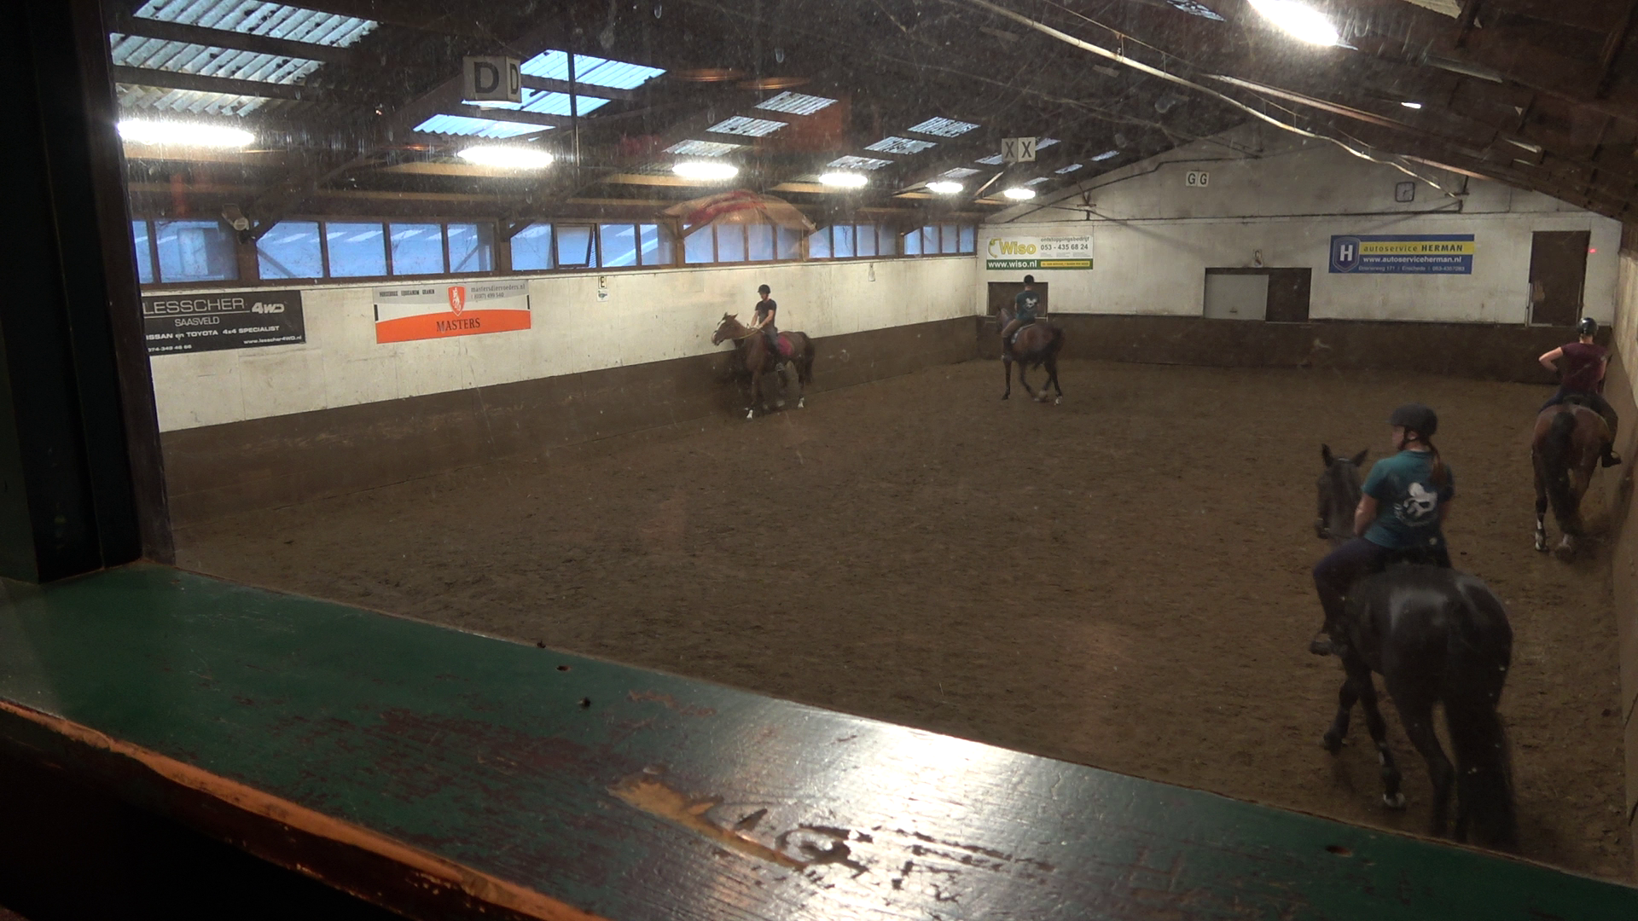

Slide 10
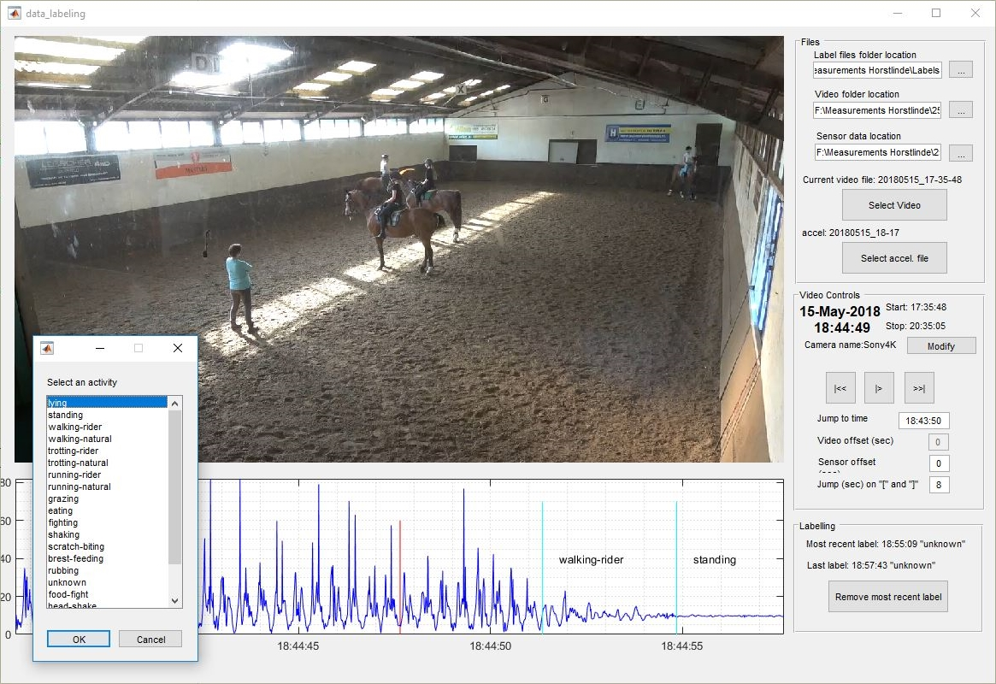
Labeling

Slide 11
Column description
Column name | Description
Ax | Raw data from accelerometer x-axis
Ay | Raw data from accelerometer y-axis
Az | Raw data from accelerometer z-axis
Gx | Raw data from gyroscope x-axis
Gy | Raw data from gyroscope y-axis
Gz | Raw data from gyroscope z-axis
Mx | Raw data from magnetometer x-axis
My | Raw data from magnetometer y-axis
Mz | Raw data from magnetometer z-axis
A3D | l2-norm (3D vector) of accelerometer axes
G3D | l2-norm (3D vector) of gyroscope axes
M3D | l2-norm (3D vector) of magnetometer axes
label | Label that belongs to datapoint
segment | Segment identifier
subject | Subject identifier
Notes:
Date Time?!

Slide 12
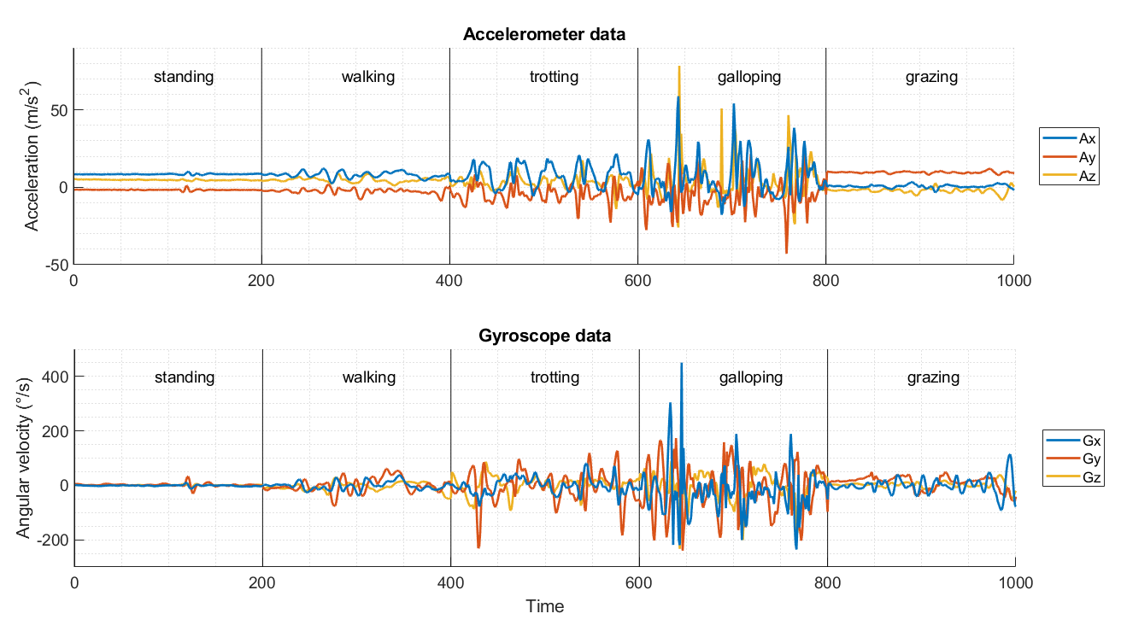

Slide 13
Number of 2-second samples
Labeled | 93303
Unlabeled | 1191658
Notes:
with 50% overlap

Slide 14
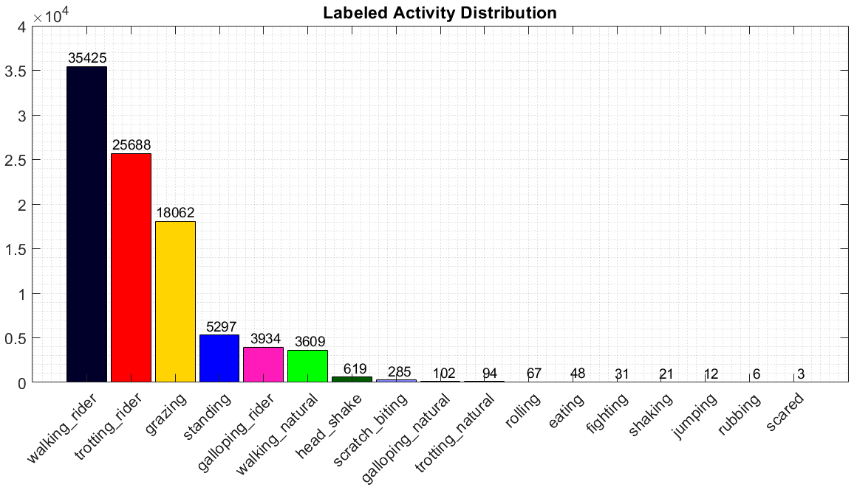
Number of samples per activity
Notes:
17 activities

Slide 15
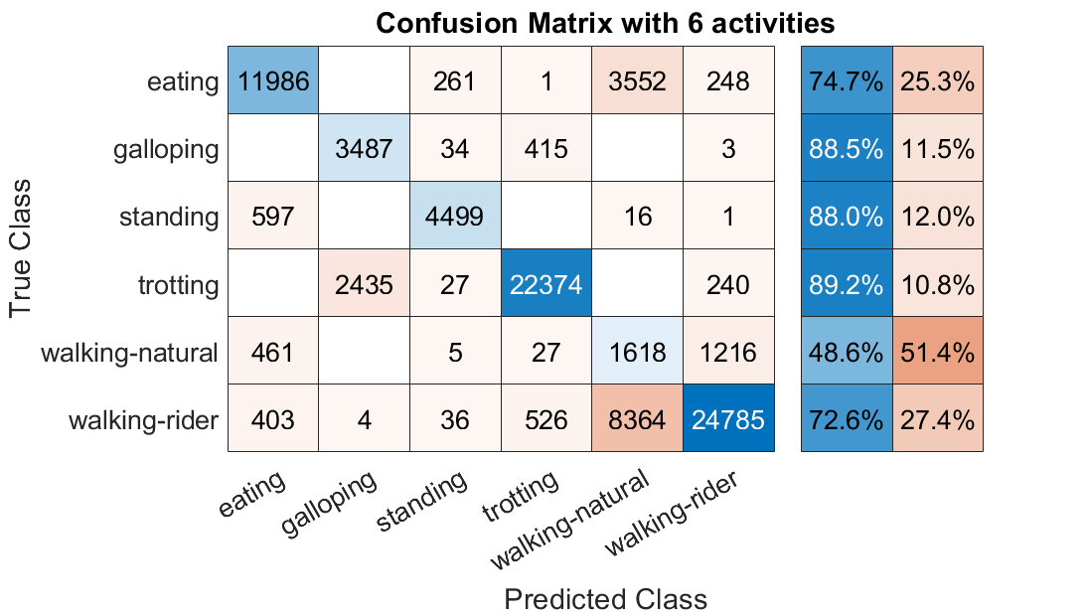
Notes:
A column-normalized column summary displays the number of correctly and incorrectly classified observations for each predicted class as percentages of the number of observations of the corresponding predicted class.

Slide 16
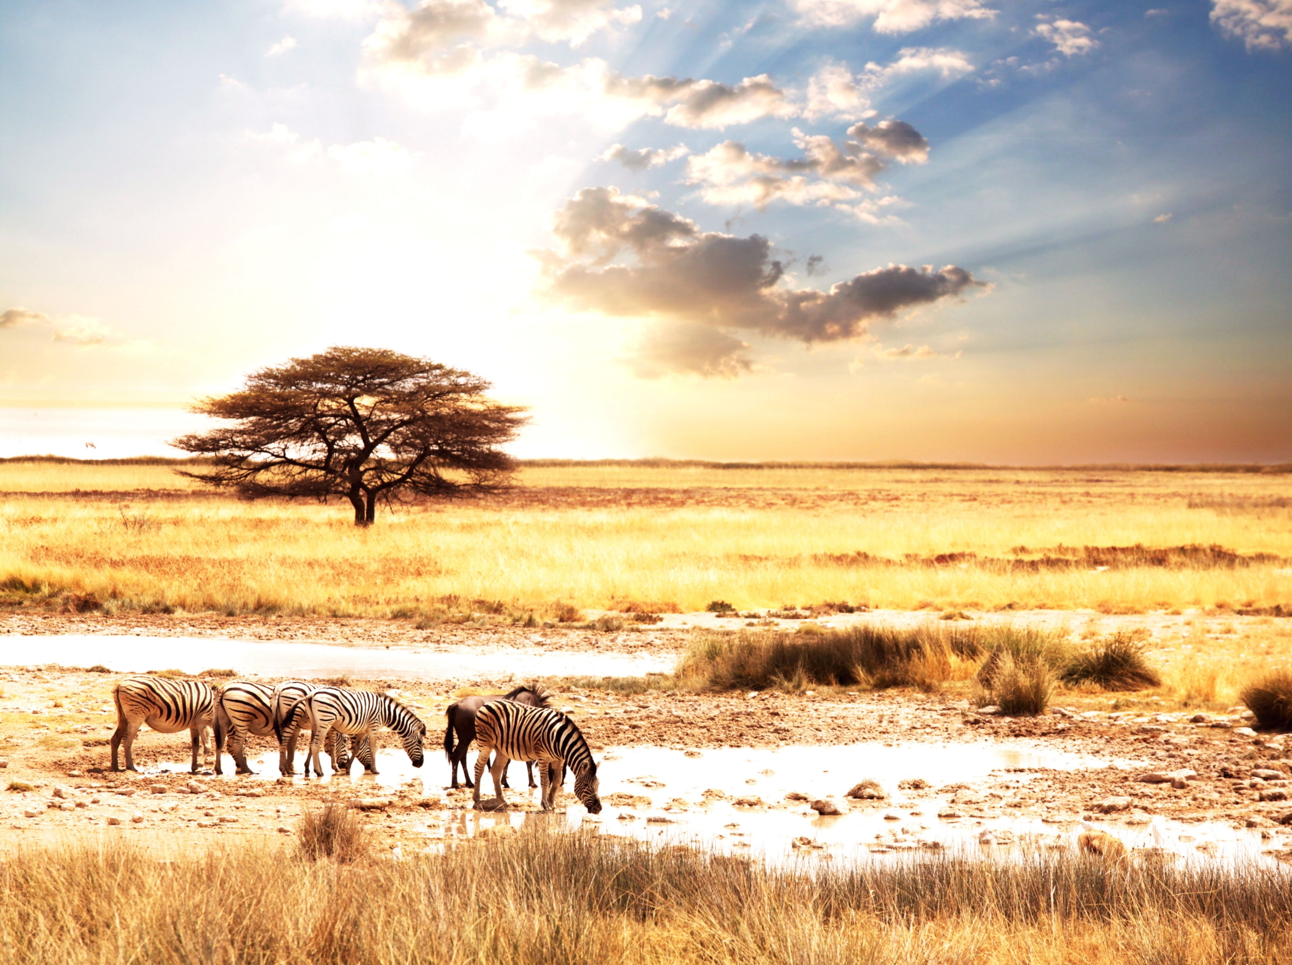
Dataset use cases
Unsupervised representation learning
Sensor-Orientation-Independent AAR
Gait analysis and comparison
Transfer learning
AAR for similar animals such as donkeys or zebras

Slide 17
Conclusions
Large dataset, especially unlabeled data
Particularly suitable for unsupervised representation learning
More labeled data for subset of subjects and activities
Lesson learned: think about prospective dataset uses outside own research objective prior to collection
Notes:
Little additional effort might extend dataset usage range

Slide 18
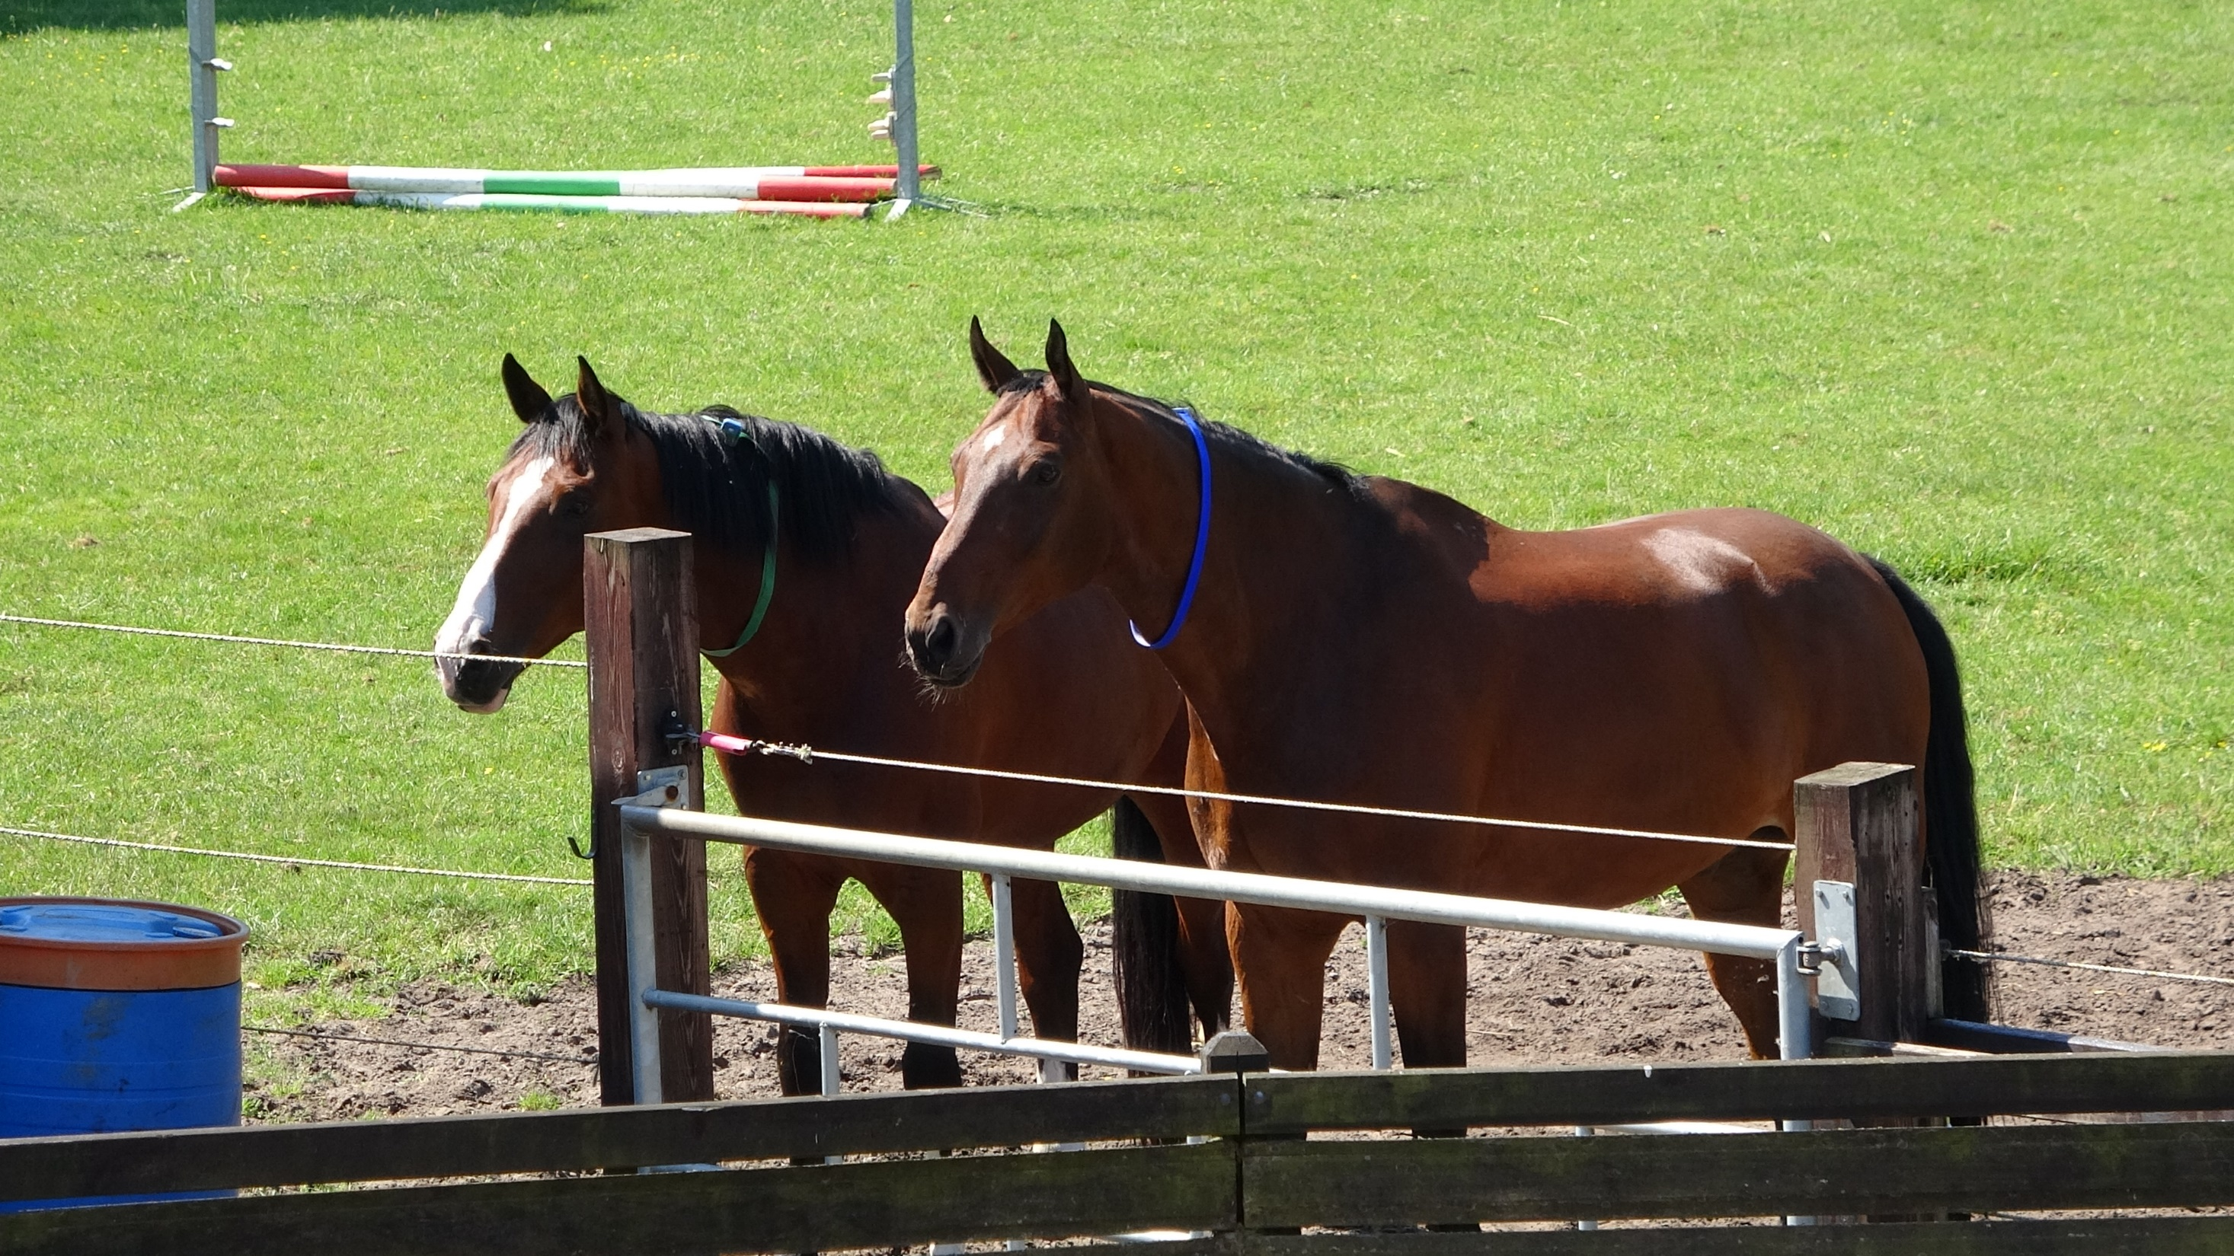
Thanks for your attention
Jacob Kamminga
University of Twente

Slide 19
Number of 2-second samples per activity
Activity | null | standing | walking-rider | walking-natural | trotting | galloping | eating | other | total
nr samples | 1191658 | 5297 | 35425 | 3609 | 25782 | 4036 | 18110 | 1044 | 1284961
fraction of labeled |  | 6% | 38% | 4% | 28% | 4% | 19% | 1%
Notes:
with 50% overlap

Slide 20
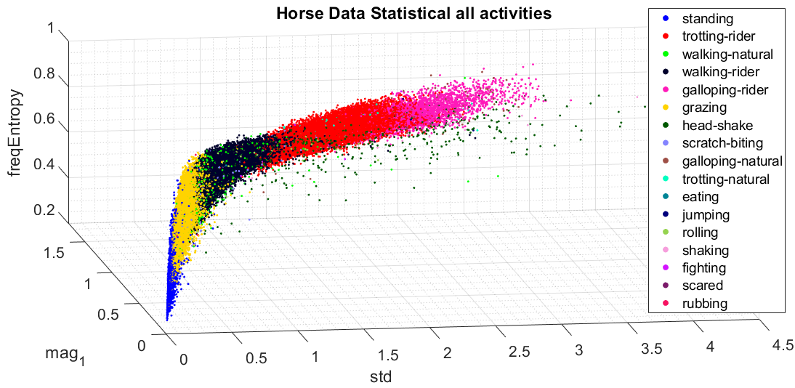

Slide 21
Evaluation
Naïve Bayes classifier
Accelerometer data from 6 subjects and 6 activities
Leave-one-subject-out cross validation
Transform 3 axes into 3D vector (l²-norm)
Features: 21 summary statistics (mean, std, … )

Slide 22
Activity | null | unknown | walking_rider | trotting_rider | grazing | standing | galloping_rider | walking_natural | head_shake | scratch_biting | galloping_natural | trotting_natural | eating | jumping | shaking | rolling | fighting | rubbing | scared | total
Galoway | 62155 | 23264 | 9653 | 6374 | 4315 | 1750 | 1030 | 1402 | 59 | 170 | 13 | 49 | 16 |  | 4 | 13 | 25 |  |  | 110292
Bacardi | 92775 | 9850 | 1317 | 1981 | 1116 | 245 | 288 | 360 |  | 22 | 40 |  |  |  | 13 |  |  | 6 |  | 108013
Driekus | 85468 | 11271 | 4024 | 2670 | 2465 | 341 | 310 | 270 | 55 | 14 | 13 | 3 | 31 |  | 4 | 23 |  |  |  | 106962
Patron | 78536 | 15156 | 5150 | 3385 | 1951 | 1244 | 709 | 388 | 37 |  | 5 | 17 |  |  |  | 31 |  |  |  | 106609
Happy | 68468 | 13606 | 8896 | 7032 | 5062 | 1186 | 689 | 746 | 238 | 8 | 7 | 6 | 1 |  |  |  |  |  |  | 105945
Zonnerante | 90431 |  |  |  |  |  |  |  |  |  |  |  |  |  |  |  |  |  |  | 90431
Duke | 81885 |  |  |  |  |  |  |  |  |  |  |  |  |  |  |  |  |  |  | 81885
Viva | 69441 | 4413 | 1066 | 700 |  | 58 | 82 | 79 | 5 | 4 |  |  |  |  |  |  |  |  | 1 | 75849
Flower | 75741 |  |  |  |  |  |  |  |  |  |  |  |  |  |  |  |  |  |  | 75741
Pan | 68628 | 1575 | 241 |  |  | 36 |  | 44 |  |  |  |  |  |  |  |  |  |  |  | 70524
Porthos | 67080 |  |  |  |  |  |  |  |  |  |  |  |  |  |  |  |  |  |  | 67080
Barino | 66517 |  |  |  |  |  |  |  |  |  |  |  |  |  |  |  |  |  |  | 66517
Zafir | 38424 | 10349 | 5078 | 3546 | 1091 | 347 | 826 | 161 | 105 | 23 | 9 | 13 |  | 12 |  |  |  |  |  | 59984
Niro | 43563 | 2740 |  |  | 85 | 20 |  | 2 |  |  |  |  |  |  |  |  |  |  |  | 46410
Sense | 38823 | 1569 |  |  | 1977 | 39 |  | 157 | 120 | 44 | 15 | 6 |  |  |  |  | 6 |  | 2 | 42758
Blondy | 31579 |  |  |  |  |  |  |  |  |  |  |  |  |  |  |  |  |  |  | 31579
Noortje | 17777 | 2878 |  |  |  | 31 |  |  |  |  |  |  |  |  |  |  |  |  |  | 20686
Clever | 17696 |  |  |  |  |  |  |  |  |  |  |  |  |  |  |  |  |  |  | 17696
total | 1094987 | 96671 | 35425 | 25688 | 18062 | 5297 | 3934 | 3609 | 619 | 285 | 102 | 94 | 48 | 12 | 21 | 67 | 31 | 6 | 3 | 1284961

Slide 23
Evaluation
Naïve Bayes classifier
Leave-one-subject-out cross validation
Accelerometer data from 6 subjects and 6 activities
Transform 3 axes into 3D vector (l²-norm)
Features: 21 summary statistics (mean, std, … )
Balancing
Majority class: random under-sampling
Minority class: oversampling using SMOTE

Slide 24
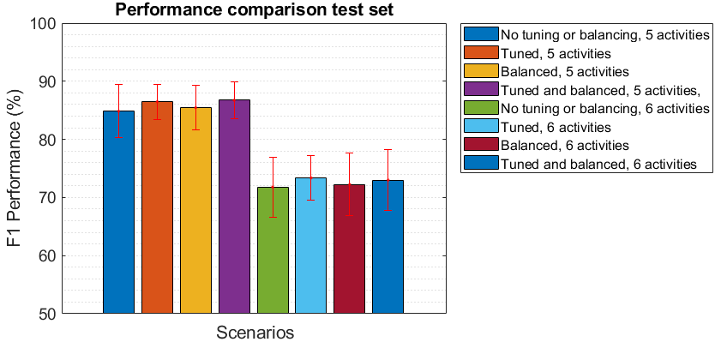

Slide 25
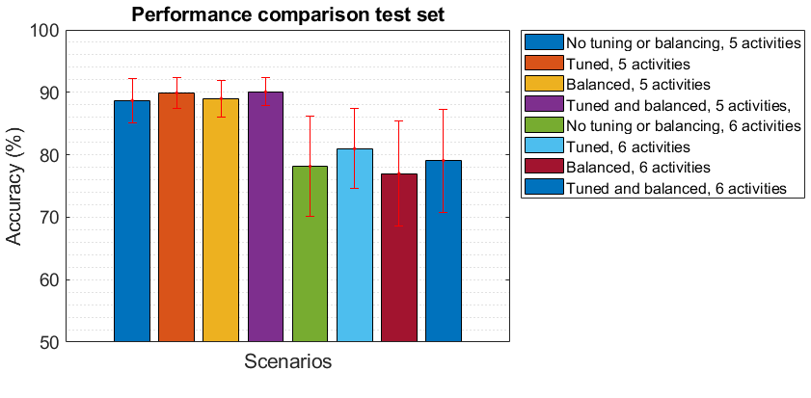

Slide 26
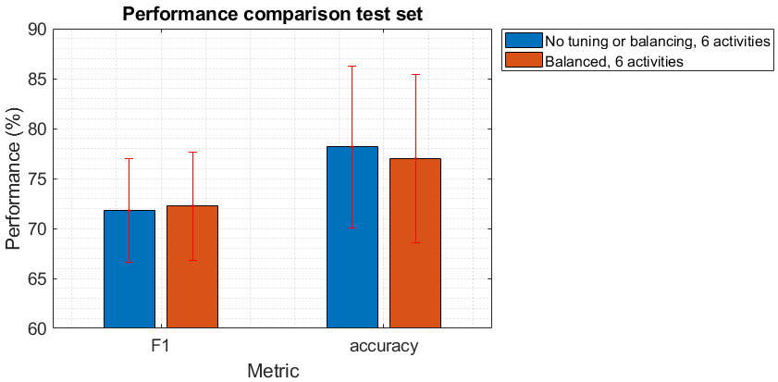

Slide 27
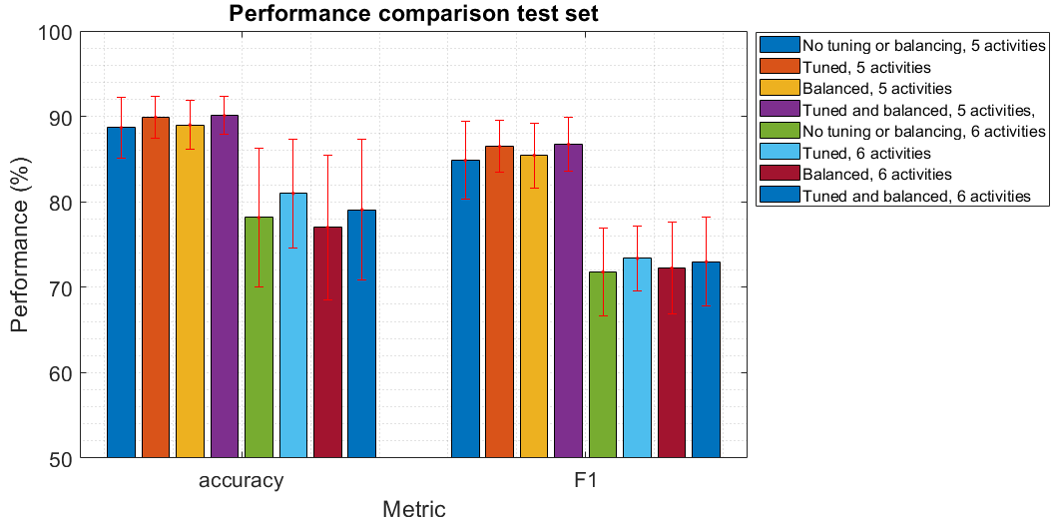

Slide 28
Summary statistics
Domain | Feature | Description
Time | Maximum | Maximum value
 | Minimum | Minimum value
 | Mean | Average value
 | Standard deviation | Measure of dispersion
 | Median | Median value
 | \nth{25} percentile | The value below which \SI{25}{\%} of the observations are found
 | \nth{75} percentile | The value below which \SI{75}{\%} of the observations are found
 | Mean low pass filtered signal | Mean value of DC components
 | Mean rectified high pass filtered signal | Mean value of rectified AC components
 | Skewness of the signal | The degree of asymmetry of the signal distribution
 | Kurtosis | The degree of 'peakedness' of the signal distribution
 | Zero crossing rate | Number of zero crossings per second
Frequency | Principal frequency | Frequency component that has the greatest magnitude
 | Spectral energy | The sum of the squared discrete FFT component magnitudes
 | Frequency entropy | Measure of the distribution of frequency components
 | Frequency magnitudes | Magnitude of first six components of FFT analysis

Slide 29
Why Animal Activity Recognition?

Slide 30
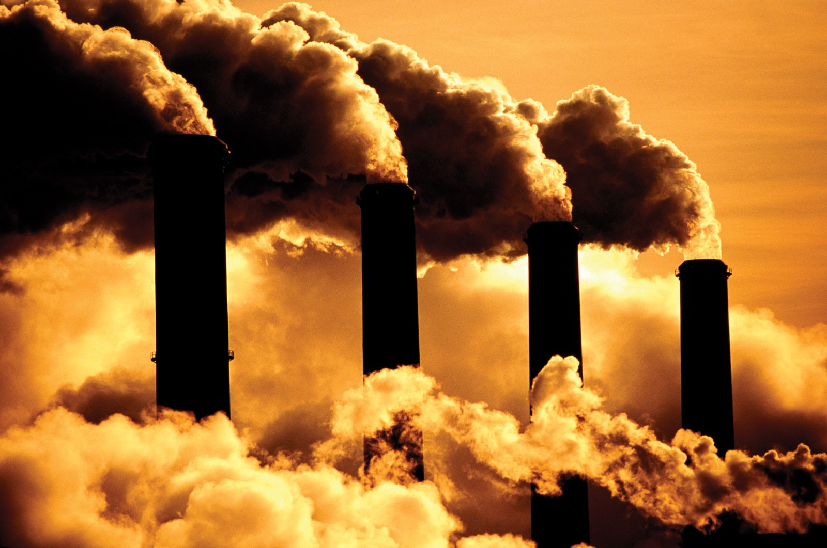
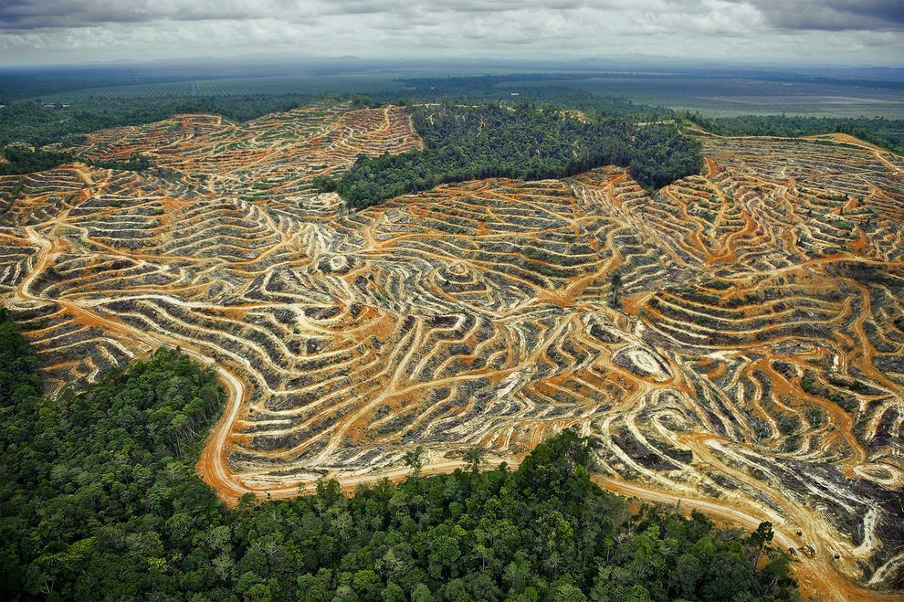
Detection of Environmental Events
Notes:
Human activities, Effects of climate change and environmental pollution
on animals

Slide 31
Poaching detection
Notes:
Human activities, Effects of climate change and environmental pollution
on animals

Slide 32
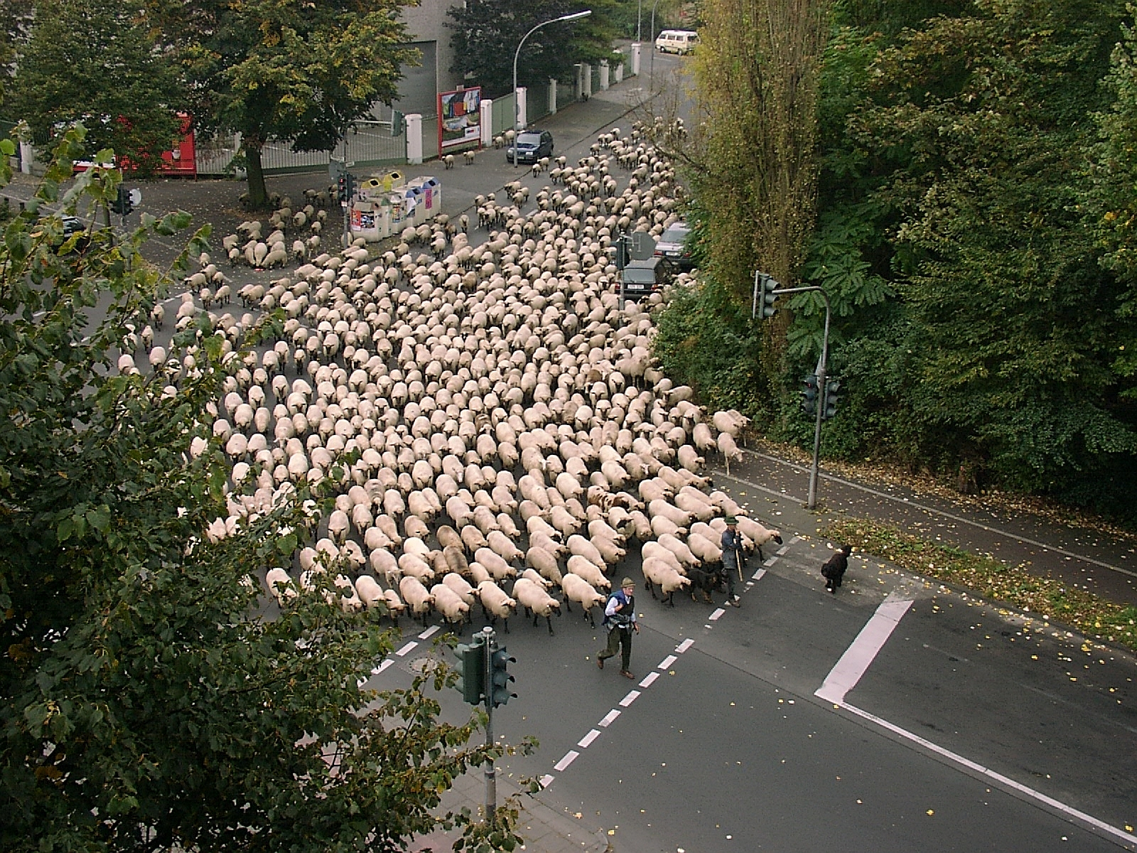
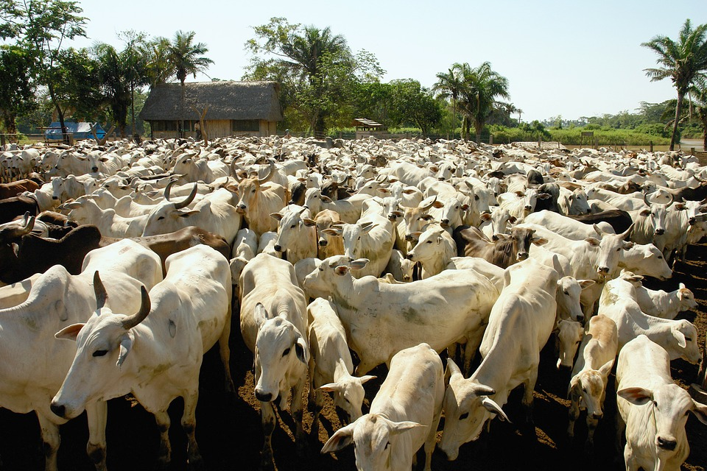
Livestock Management
Notes:
Activity recognition of livestock not only enables better healthcare but also improve management (e.g. show when cow can be inseminated)

Slide 33
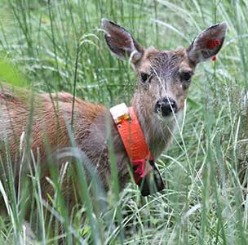
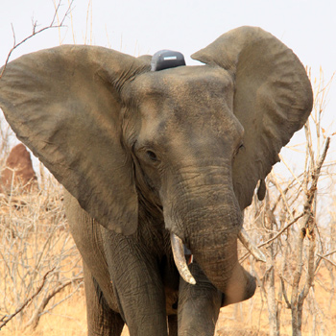
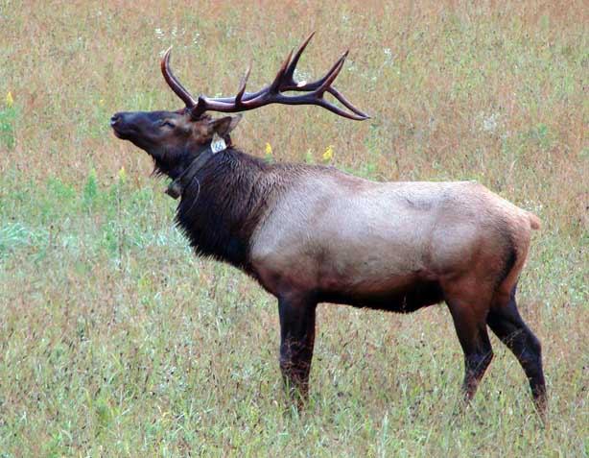
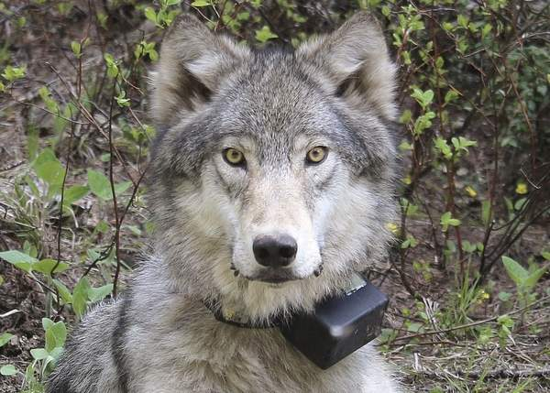
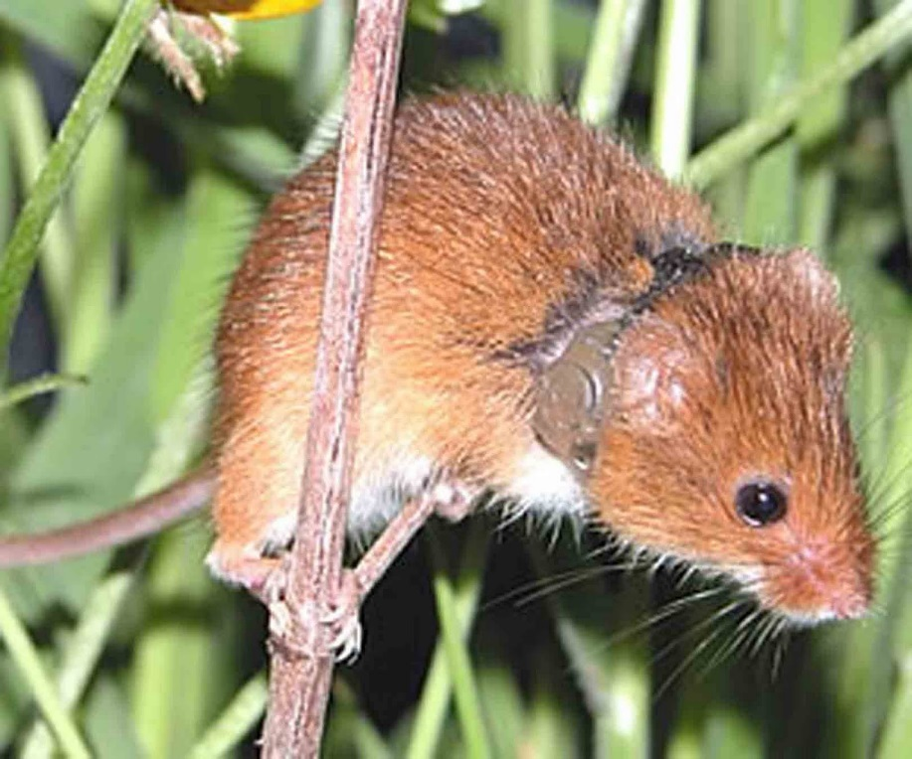
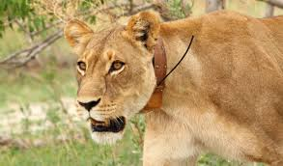
Wildlife Conservation and Movement Ecology
Notes:
Previous work subsequent retrieval and shows heterogeneity

